Slide 1
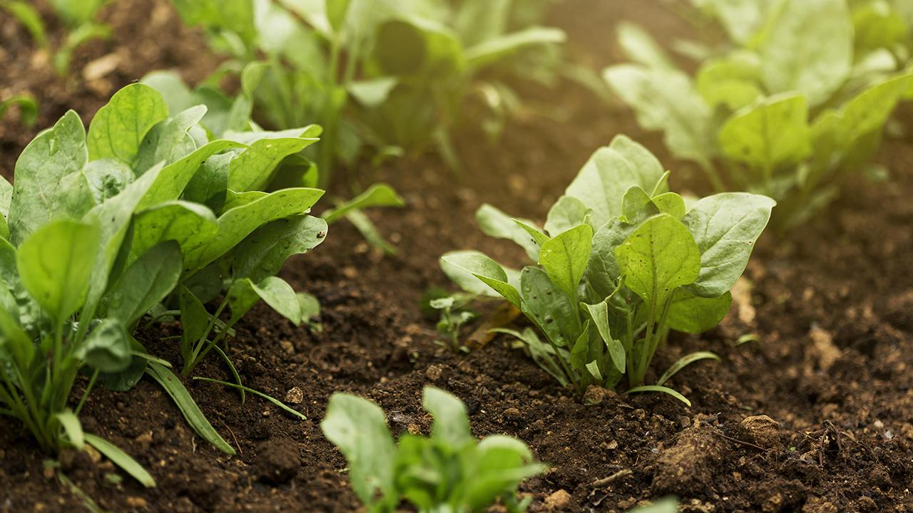
Spatial Computing Project
GitHub Link: https://github.com/Bambo0st/SpatialProj
Goutham U R (IMT2021045)
Adithya N (IMT2021054)
Meher Ashish N (IMT2021085)

Slide 2
Table of contents
Result
Overview
01
04
Dataset
Conclusion
02
05
Methodology
Project stages
03
06

Slide 3

01
Overview

Slide 4
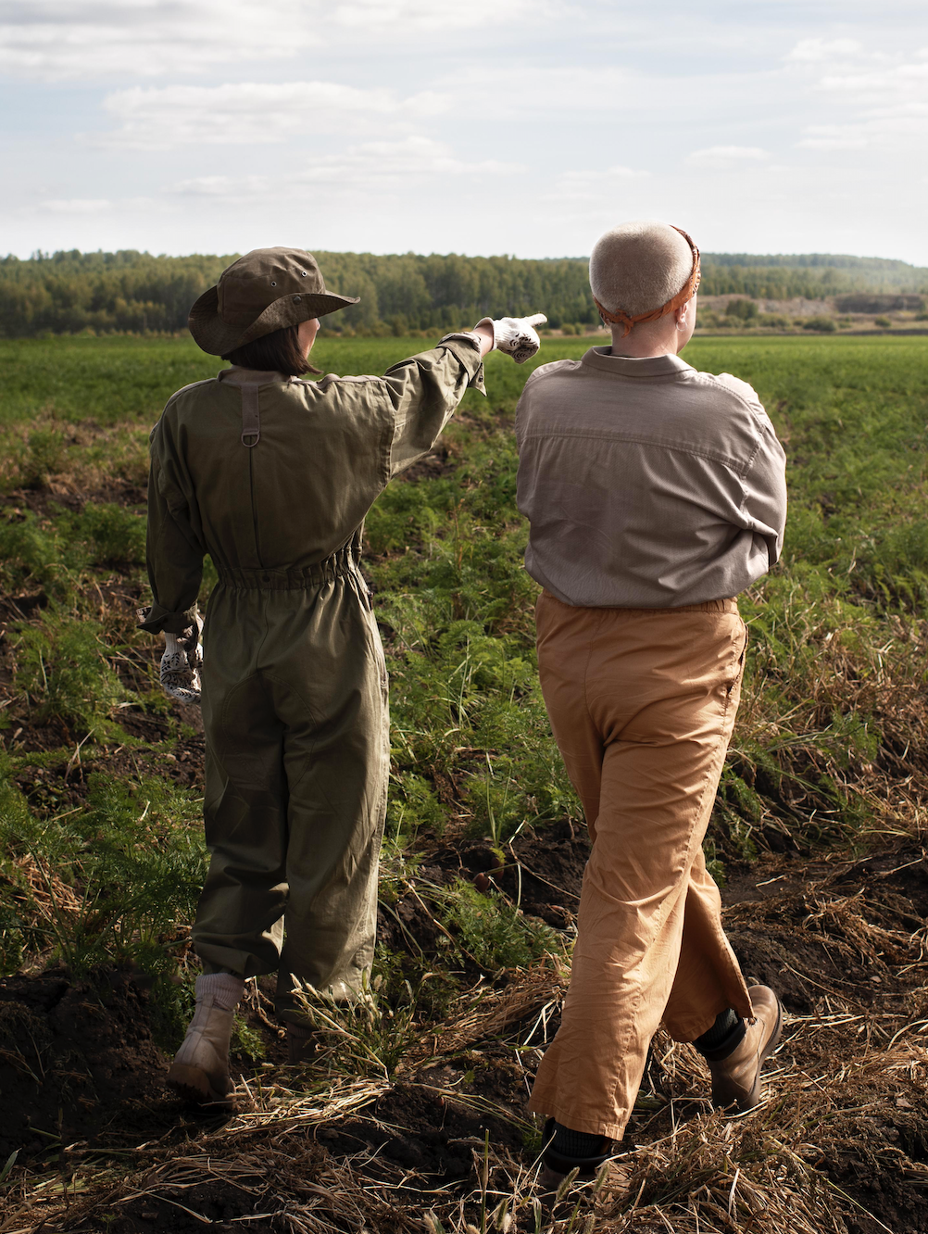
Problem vs. solution
Problem
Develop a lightweight and efficient model for automated plant disease classification.
Solution
Use different Machine Learning Models to predict the diseases.

Slide 5
Project Stages
1st Phase
Selected the appropriate dataset - Plant Village dataset. Analysis of the dataset and choose proper Feature Extraction methods.
2nd Phase
Trained different ML models like Decision Trees, Random Forests and used algorithms like KNN, XgBoost using the original images without feature extraction.
3rd Phase
Trained the ML model using the feature extraction and saw relatively considerable change in accuracy and F1 score.

Slide 6
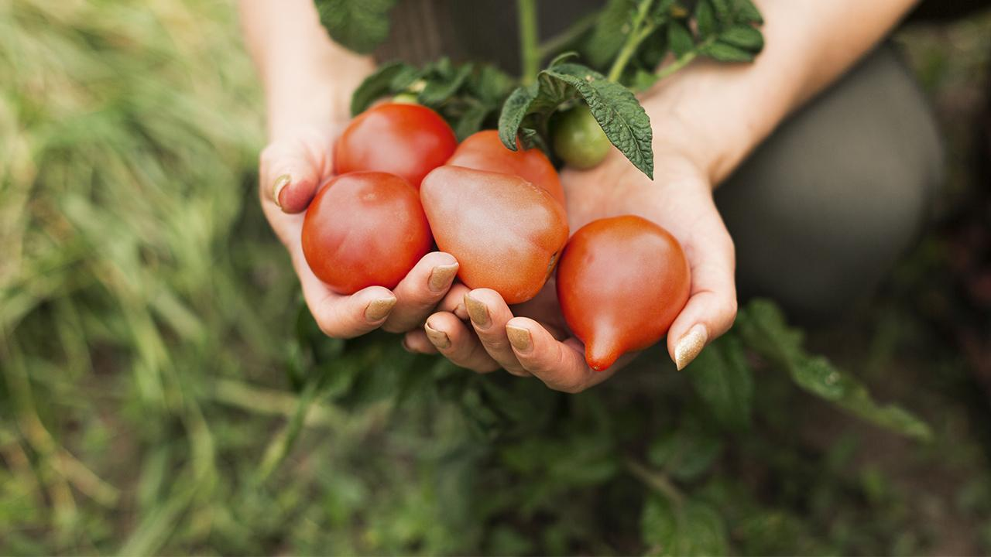
02. Dataset
https://www.kaggle.com/datasets/emmarex/plantdisease

Slide 7
Plant Village Dataset
The Plant Village dataset is a comprehensive collection of images featuring leaves from three common plants: Tomato, Potato, and Pepperbell.
The dataset includes images of both normal healthy leaves and leaves affected by various diseases, providing a diverse range of examples for analysis.
Plants:
Tomato
Potato
Pepperbell

Slide 8
Diseases/Classes
Tomato__Tomato_mosaic_virus
Tomato_Late_blight
Tomato_Leaf_Mold
Tomato__Tomato_YellowLeaf__Curl_Virus
Tomato_Bacterial_spot
Tomato_Septoria_leaf_spot
Tomato_healthy
Tomato_Spider_mites_Two_spotted_spider_mite
Tomato_Early_blight
Tomato__Target_Spot
Potato___Early_blight
Potato___Late_blight
Potato___healthy
Pepper__bell___healthy
Pepper__bell___Bacterial_spot

Slide 9
Significance:
Use cases:
Availability:
The dataset is valuable for researchers, developers, and practitioners in the fields of computer vision and machine learning, particularly in the domain of plant pathology.
Plant disease detection
Yield prediction
Crop monitoring
Agricultural research and development
The Plant Village dataset can be accessed through online repositories such as Kaggle or GitHub.

Slide 10
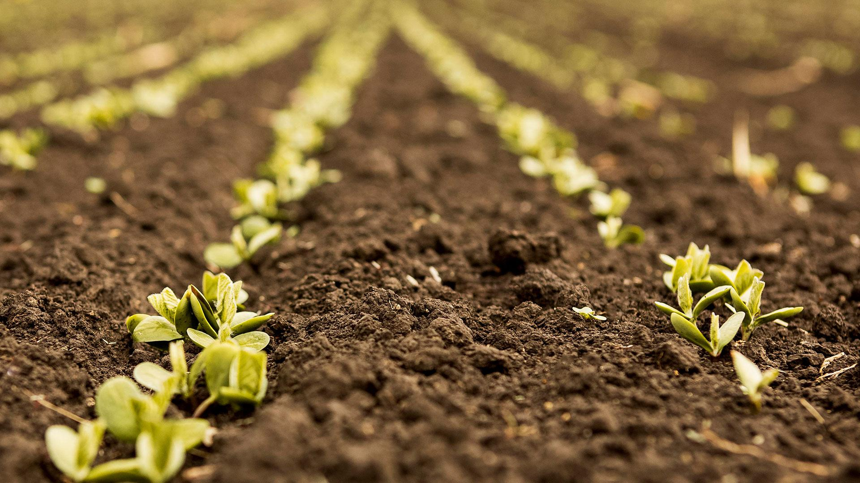
03
Methodology

Slide 11
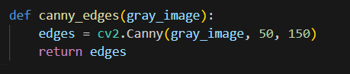
Feature Extraction Techniques & Methods
Gray Scale Conversion Method: This process converts the original color image into grayscale image.
Canny Edge Detection: Canny edge detection is used to identify edges in the grayscale image. This can capture important structural information about the objects in the image.
I

Slide 12
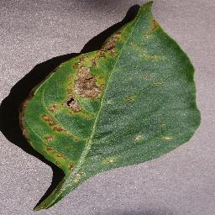
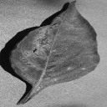
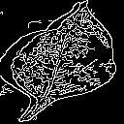
Images
Gray Scale Image
Canny Edge Detection.
Pepper with Bacterial Spot Disease

Slide 13
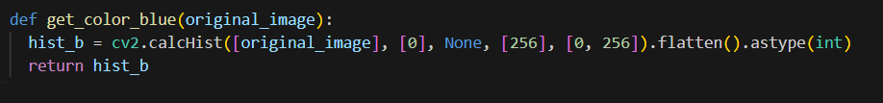
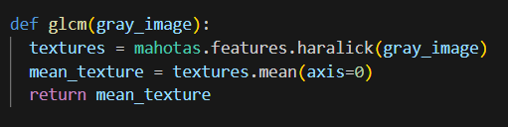
Feature Extraction Techniques
2) Color Histograms: Color histograms are computed for each channel (B, G, R) of the original image. Histograms represent the distribution of pixel intensities in each channel.
3) GLCM Texture Features: Gray-Level Co-occurrence Matrix (GLCM) texture features are computed using the Mahotas library.

Slide 14
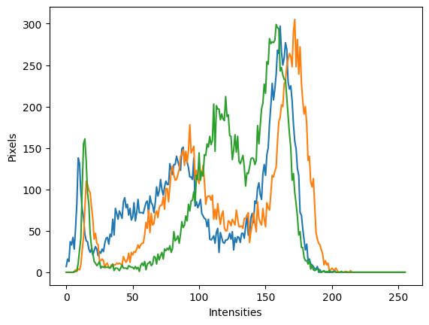
Feature Extraction Techniques
4) Hu Moments: Provides invariant shape descriptors, making them robust to translation, rotation, and scale variations, thus capturing geometric information in the image.
Texture Based: GLCM
Color Based: Color Based Histogram
Shape Based: Hu Moments
Colour Histogram for Pepper Bacterial Spot

Slide 15

Feature Extraction
These features aim to capture different aspects of the images that are relevant for distinguishing between healthy and diseased plants.

Slide 16
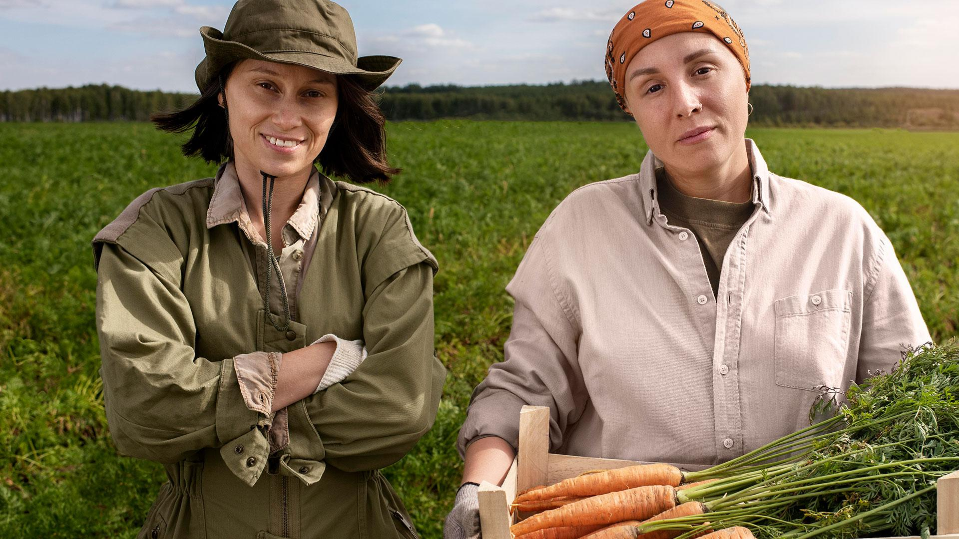
04
Results

Slide 17
Accuracy Scores for Different ML Models
Plant | Model | Accuracy Score | F1 Score | Feature Extraction Used
Tomato | KNN Random Forest XgBoost Decision Tree | 0.533 0.69 0.841 0.416 | 0.53 0.68 0.84 0.414 | Y
Potato | KNN Random Forest XgBoost Decision Tree | 0.69 0.876 0.942 0.740 | 0.663 0.848 0.938 0.739 | Y
PepperBell | KNN Random Forest XgBoost Decision Tree | 0.715 0..8825 0.945 0.77 | 0.70 0.861 0.945 0.76 | Y

Slide 18
Challenges Faced
Took a lot of time to train the data due to computational limit of the laptop and sometimes it even crashed.
Even extracting features from the images took long time due to that trained only on selective models.
Main Achievement
While people used Neural Network to get best accuracies (~98%) we used only Random Forests and XgBoost to get an average accuracy of
91%.

Slide 19
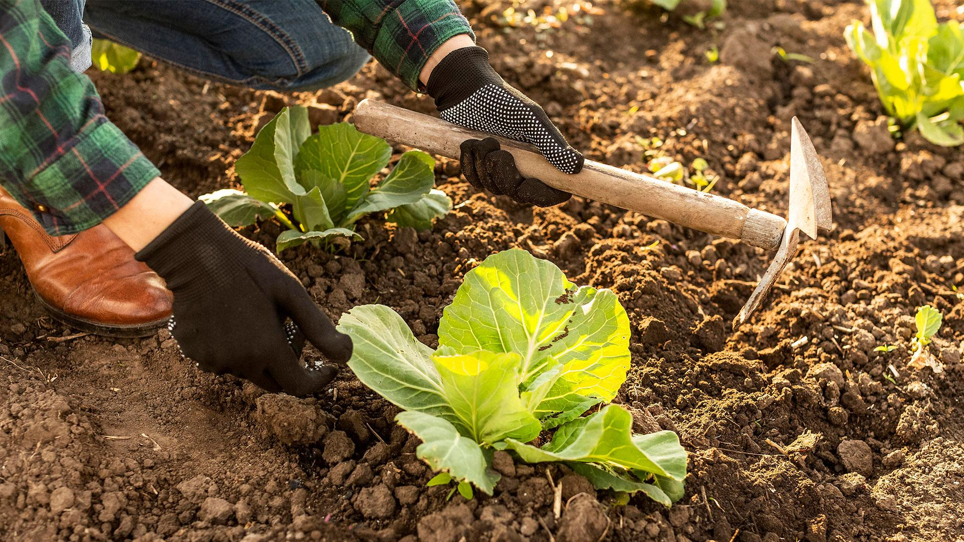
05
Conclusion

Slide 20
Result Summary
Considering features - Feature extraction led to improved performance in every model when considering features.
Intermodal Comparisons - XG-Boost outperformed KNN, Decision Trees, and Random Forests, delivering the most favorable results among the models.
Best results - Best results were observed when XG-Boost was used along with feature extraction and the accuracy obtained was 94.5%

Slide 21


